Slide 1
TRENDING YOUTUBE VIDEOS
A DATA SCIENCE PROJECT BY THE GEEK SQUAD

Slide 2
INTRODUCTION
Go to the app store on your phone and try to find an app to watch videos. YouTube comes up. YouTube is the most popular app and website to watch any video you would like to see. YouTube is an American video-sharing website headquartered in San Bruno, California. Three people Chad Hurley, Steve Chen, and Jawed Karim, created the service in February 2005. Google bought the site in November 2006 for US$1.65 billion; YouTube now operates as one of Google’s affiliates. The app allows you to explore new content, music, news, and more with the official app or the website. They also allow you to subscribe to channels with your favorite content, share with friends, or upload your videos for everyone to see. YouTube most popular videos are trending. Trending helps viewers see what’s happening on YouTube and in the world. Trending aims to surface videos that a wide range of viewers would find interesting. Some trends are predictable, like a new song from a famous artist or a new movie trailer. Others are surprising, like a viral video. Trending is not personalized and displays the same list of trending videos in each country to all users. The list of trending videos is updated roughly every 15 minutes. With each update, videos may move up, down, or stay in the same position in the list. YouTube maintains a list of the top trending videos. YouTube uses a combination of factors, including measuring several views, shares, comments, and likes to make the commercials and determine trending videos. This dataset is a daily record of the top trending YouTube videos and the factors that influences them. Analyzing this dataset, we can look at the main factors that include making the videos trending, such as likes, dislikes, and comments. We can view what is needed to make a video be on the trending list. To analyze this data plan is to use linear regression with the variables likes, dislikes, comments, trending date and publish time and names. We aim to help YouTube to provide users with a threshold so they can know precisely know what is expected for views, likes, dislikes and comments for their video to be considered as a trending video.

Slide 3
REQUIRED PACKAGES
To properly execute this project on RStudio, we had to download a few packages.
The packages we used were:
dplyr
lattice
getwd
ggplot2
caret

Slide 4
PARTICULAR DATA WRANGLING TECHNIQUES
The data set was provided in a nearly cleaned manner. However, multiple data wrangling techniques were performed on the data frame to transom it into a document that can be analyzed. These techniques include removing unnecessary variables, changing the names of some columns, adding variables, and including functions for calculation.
This function comes with the tidyr package to select the variables that I would like to use

Slide 5
GLIMPSE FUNCTION
## Observations: 200
## Variables: 7
## $ trending_date <fct> 17.13.11, 17.13.11, 17.13.11, 17.13.11, 17.13.11, 17....
## $ title <fct> "The Trump Presidency: Last Week Tonight with John Ol...
## $ publish_time <fct> 2017-11-13T07:30:00.000Z, 2017-11-12T19:05:24.000Z, 2...
## $ views <int> 993345, 2568721, 118585, 1867990, 669608, 1926875, 54...
## $ likes <int> 65551, 132724, 6183, 123933, 21357, 15159, 4158, 5512...
## $ dislikes <int> 3544, 4495, 361, 1836, 591, 2288, 321, 291, 156, 1041...
## $ comment_count <int> 8128, 7494, 1374, 16635, 3050, 1837, 2882, 251, 1025,...

Slide 6
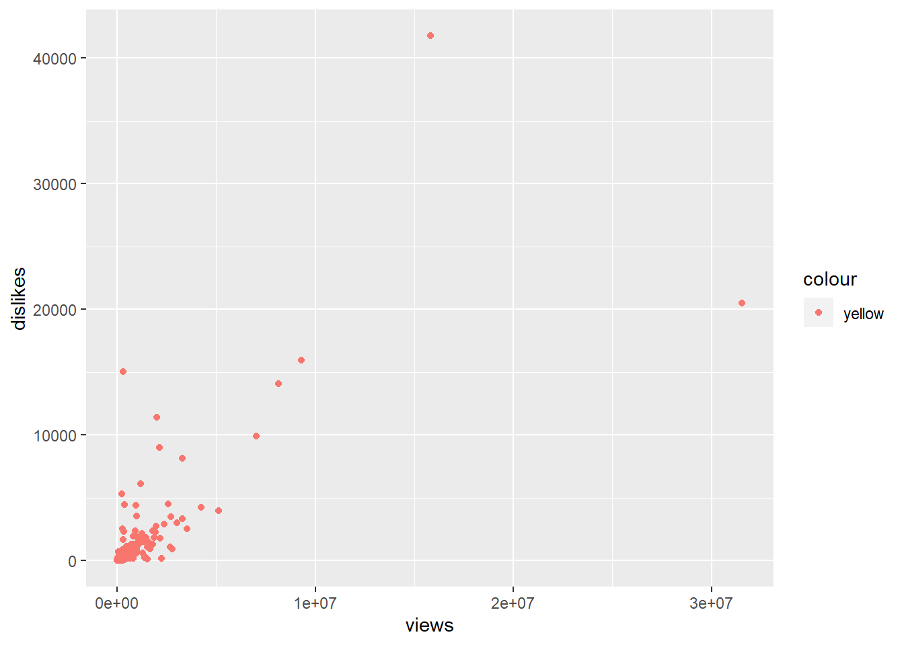
DISLIKES VS. VIEWS
The higher the number of views the higher the number of likes. Which is the opposite of what we would think because if views is what would makes the video trending.

Slide 7
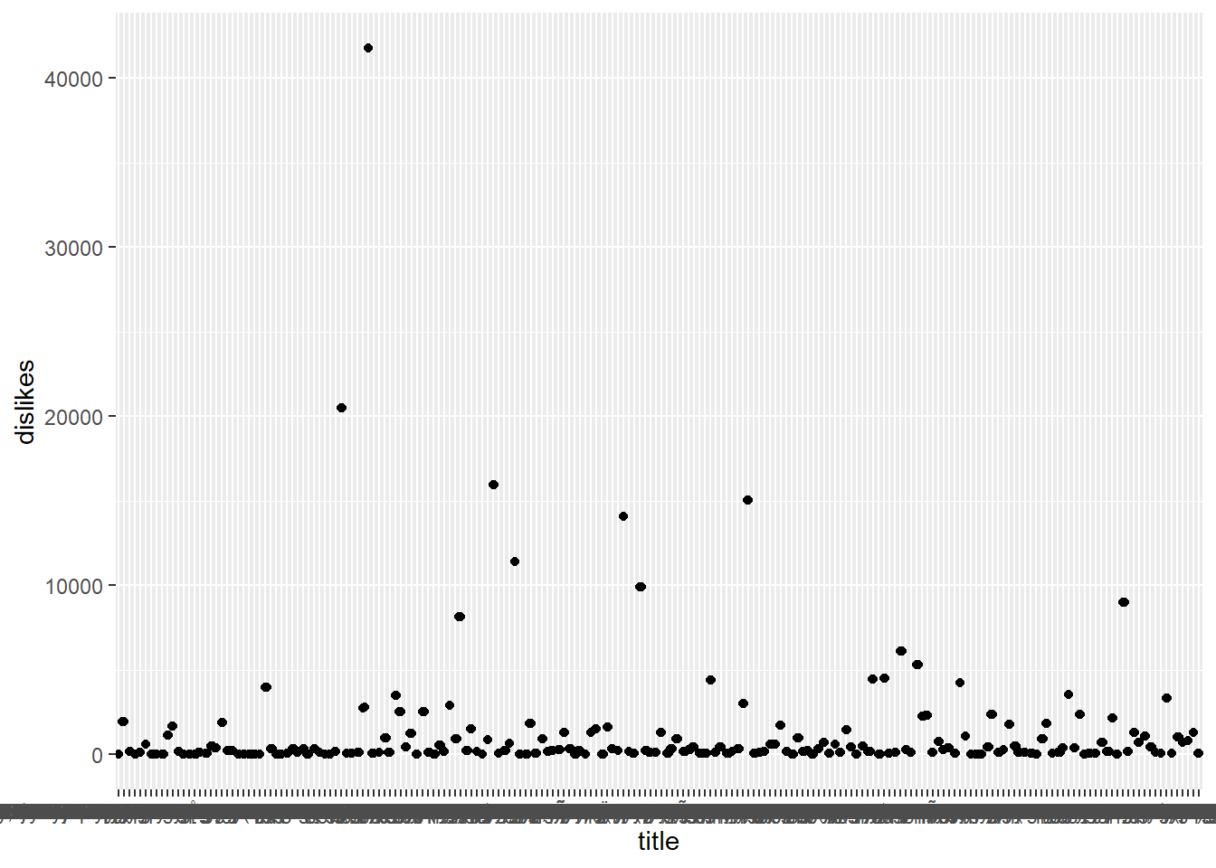
DISLIKES VS. TITLES
The graph shows the titles aren’t significant.

Slide 8
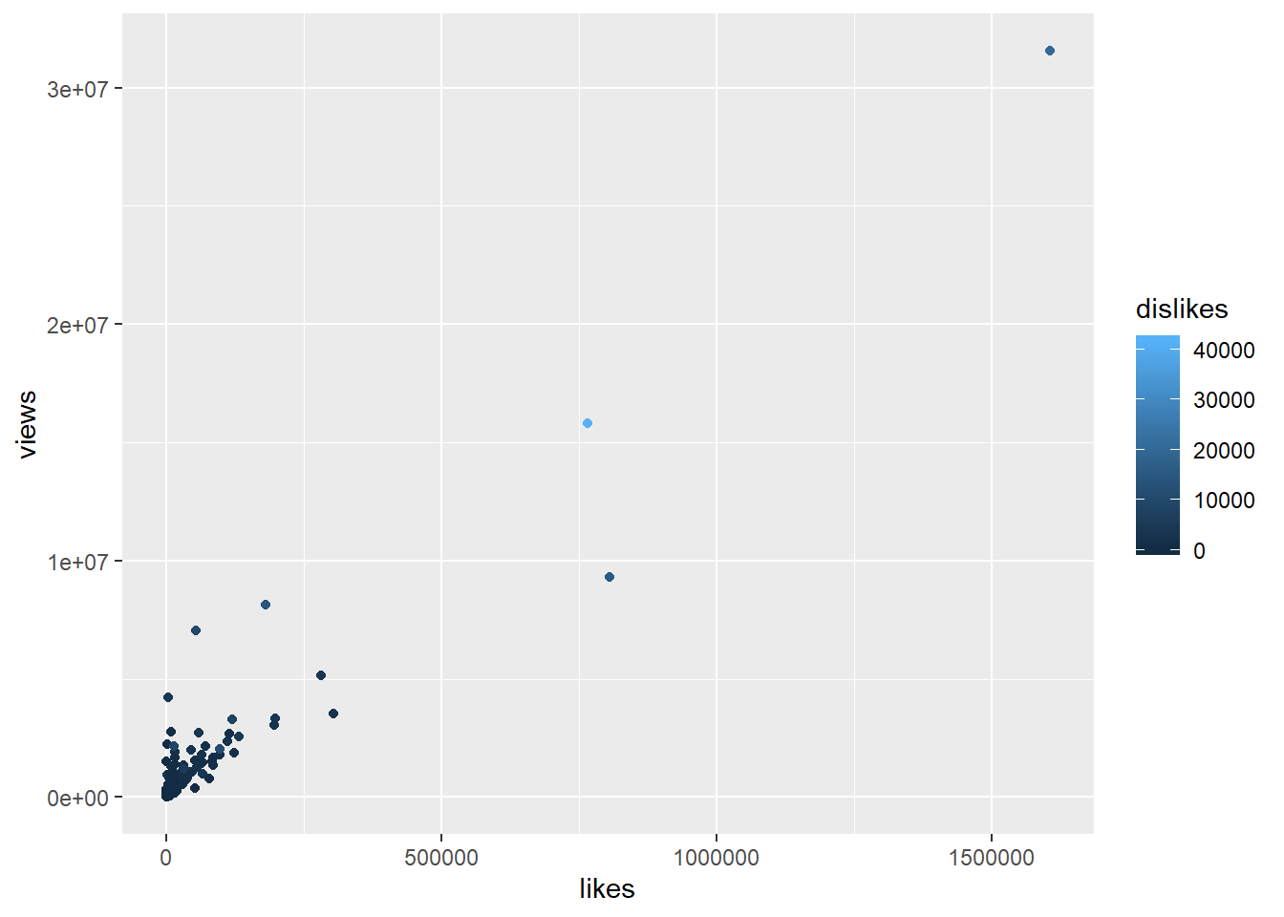
VIEWS VS. LIKES

Slide 9
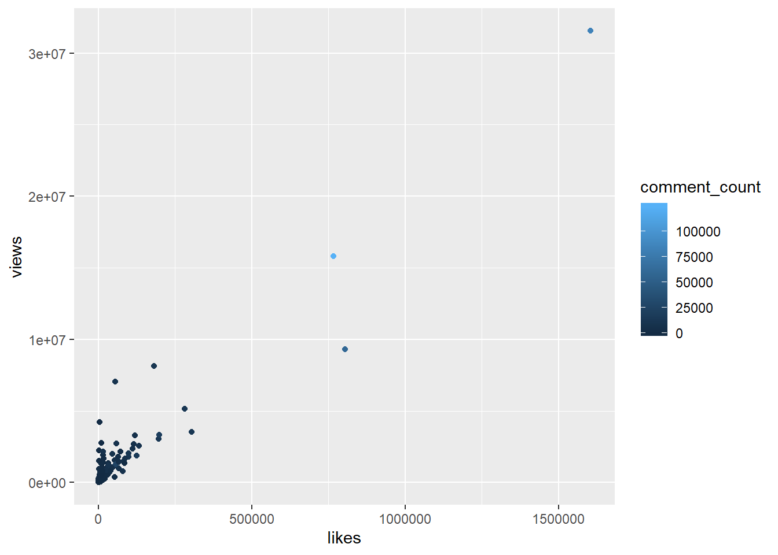
VIEWS VS. LIKES

Slide 10
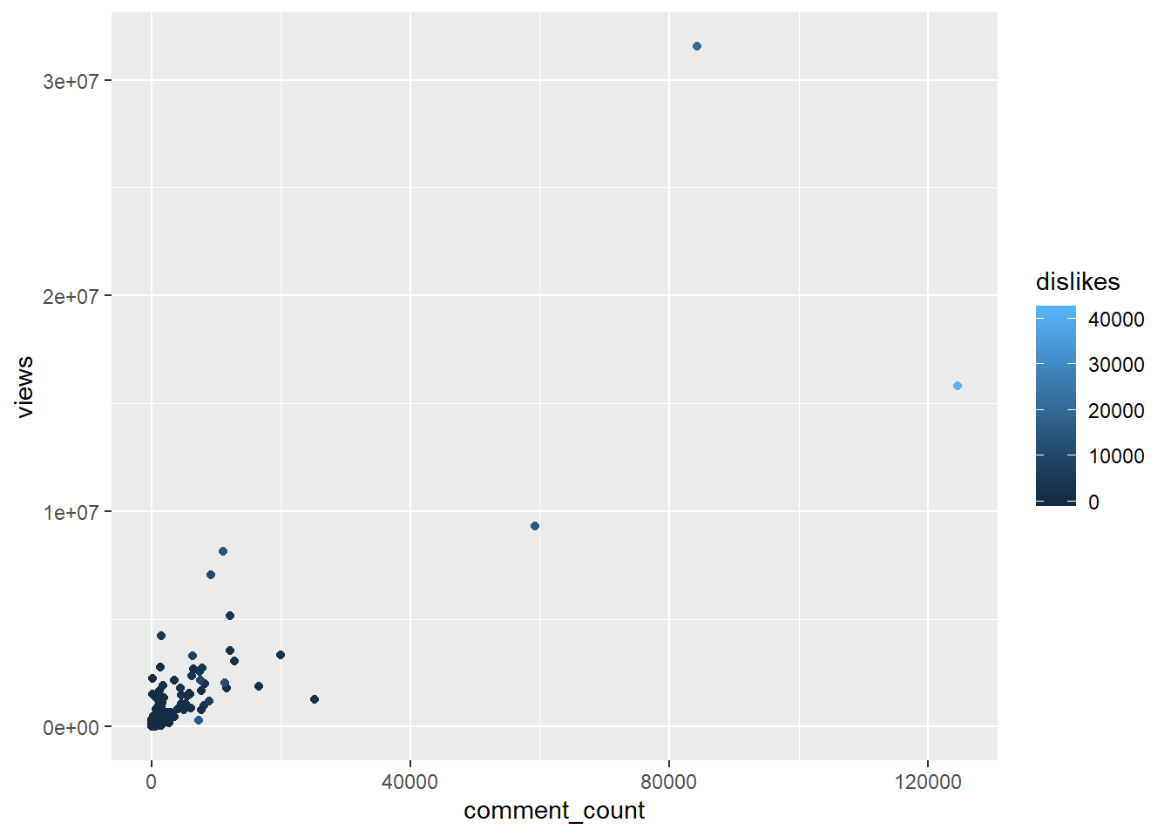
VIEWS VS. COMMENT COUNT

Slide 11
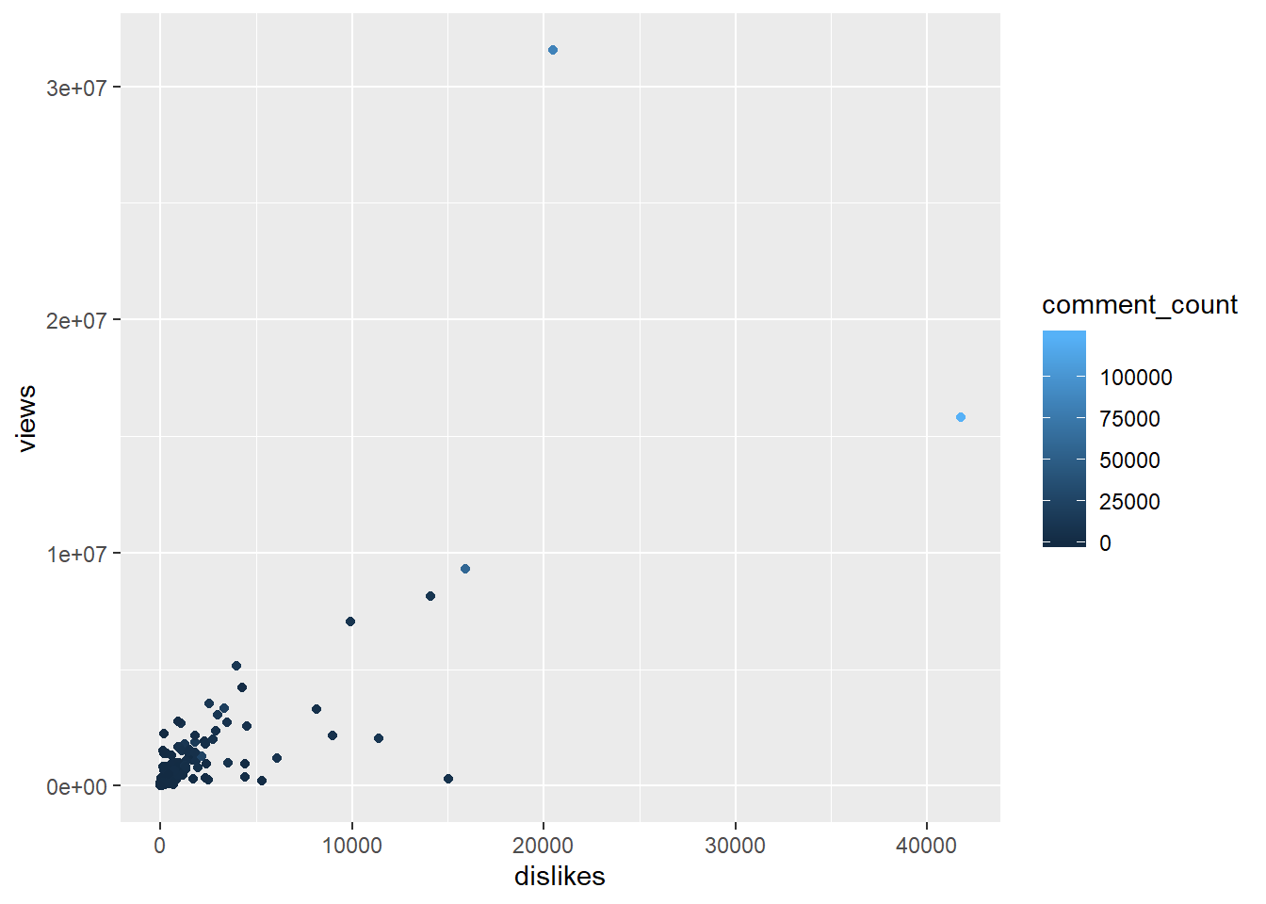
VIEWS VS. DISLIKES
The relationship between the actual variables does not appear to have a strong linear relationship.A large amount of the data is clumped around the (0,0) point. Nevertheless, there is a positive relationship between the variables in the clean data set. It is worthwhile to note that videos that have a low number of dislikes and a moderately high number of views have high levels of comments.

Slide 12
CLEAN DATA SET
## # A tibble: 190 x 4
## comment_count n_comments mean_dislikes std_error
## <int> <int> <dbl> <dbl>
## 1 0 7 132. 120.
## 2 1 2 0.5 0.5
## 3 2 2 0 0
## 4 10 1 5 NA
## 5 11 1 2 NA
## 6 17 2 56.5 22.5
## 7 18 1 2 NA
## 8 19 1 6 NA
## 9 22 1 23 NA
## 10 30 1 50 NA
## # ... with 180 more rows

Slide 13
MACHINE LEARNING
The plots created, and we have a cleaner understanding of the dat. The models below explores the relationship between the dependent variables and the independent variables. After creating multiple models, we conclude that the model of best fit has a dependent variable is views, and the independent variables are likes, dislikes, and comments. Since the dependent variable is a numerical value, multiple linear regression will be used as the machine learning technique.For the machine learning portion of the capstone project, the number of views is predicted given the number of likes, dislikes, and comments.
Before the linear model is created, the data is divided into testing and training data. The divide used is 80% to train the model and 20% of the data to test the model. To determine if the model of best fit is a good model the metrics R-squared RMSE, and p-value are observed. The model is built using the original data and not the daily means of the the data. The code below splits the data set. Set seed gives a starting point for splitting the data.

Slide 14
MODEL 1
In model1, the dependent variable is views, and the dependent variable is dislikes. The independent variable is statistically significant but R2. R2 is only 0.6216. We can produce a better model.
##
## Call:
## lm(formula = views ~ dislikes, data = training, subset = likes)
##
## Residuals:
## Min 1Q Median 3Q Max
## -916612 -100861 -34129 396267 590524
##
## Coefficients:
## Estimate Std. Error t value Pr(>|t|)
## (Intercept) 71777.4 199924.4 0.359 0.7289
## dislikes 444.7 111.9 3.973 0.0041 **
## ---
## Signif. codes: 0 '***' 0.001 '**' 0.01 '*' 0.05 '.' 0.1 ' ' 1
##
## Residual standard error: 498400 on 8 degrees of freedom
## (149 observations deleted due to missingness)
## Multiple R-squared: 0.6637, Adjusted R-squared: 0.6216
## F-statistic: 15.78 on 1 and 8 DF, p-value: 0.004102

Slide 15
MODEL 2
In model2, the dependent variable is views, and the dependent variable is dislikes. The independent variable is statistically significant but R2. R2 is only 0.7807. We can produce a better model.
##
## Call:
## lm(formula = views ~ comment_count, data = training, subset = likes)
##
## Residuals:
## Min 1Q Median 3Q Max
## -654848 -79934 -67 81227 660839
##
## Coefficients:
## Estimate Std. Error t value Pr(>|t|)
## (Intercept) 30513.10 151320.57 0.202 0.84523
## comment_count 325.46 56.62 5.748 0.00043 ***
## ---
## Signif. codes: 0 '***' 0.001 '**' 0.01 '*' 0.05 '.' 0.1 ' ' 1
##
## Residual standard error: 379500 on 8 degrees of freedom
## (149 observations deleted due to missingness)
## Multiple R-squared: 0.8051, Adjusted R-squared: 0.7807
## F-statistic: 33.04 on 1 and 8 DF, p-value: 0.00043

Slide 16
MODEL 3
In model3, the dependent variable is views, and the independent variables are dislikes, and comments. The independent variables are statistically significant but R2. R2 is only 0.755. We can produce a better model.
##
## Call:
## lm(formula = views ~ dislikes + comment_count, data = training)
##
## Residuals:
## Min 1Q Median 3Q Max
## -3910645 -308934 -227326 69529 3916867
##
## Coefficients:
## Estimate Std. Error t value Pr(>|t|)
## (Intercept) 325753.51 69265.70 4.703 5.58e-06 ***
## dislikes 232.10 33.94 6.839 1.68e-10 ***
## comment_count 55.60 13.02 4.270 3.37e-05 ***
## ---
## Signif. codes: 0 '***' 0.001 '**' 0.01 '*' 0.05 '.' 0.1 ' ' 1
##
## Residual standard error: 827800 on 157 degrees of freedom
## Multiple R-squared: 0.758, Adjusted R-squared: 0.755
## F-statistic: 245.9 on 2 and 157 DF, p-value: < 2.2e-16

Slide 17
MODEL 4
In model4, the dependent variable is views, and the independent variables are likes, dislikes, and comment_count. The independent variables are statistically significant but R2. R2 is only 0.8383
0.8383. This is the best model for all possible combinations of more than one independent variable from the choice of, likes, dislikes, and comment count.
##
## Call:
## lm(formula = views ~ dislikes + comment_count + likes, data = training)
##
## Residuals:
## Min 1Q Median 3Q Max
## -3128790 -199845 -147366 82714 4176630
##
## Coefficients:
## Estimate Std. Error t value Pr(>|t|)
## (Intercept) 204729.204 57837.194 3.540 0.000528 ***
## dislikes 218.804 27.611 7.925 4.07e-13 ***
## comment_count -39.937 14.943 -2.673 0.008329 **
## likes 15.468 1.709 9.050 5.46e-16 ***
## ---
## Signif. codes: 0 '***' 0.001 '**' 0.01 '*' 0.05 '.' 0.1 ' ' 1
##
## Residual standard error: 672500 on 156 degrees of freedom
## Multiple R-squared: 0.8413, Adjusted R-squared: 0.8383
## F-statistic: 275.7 on 3 and 156 DF, p-value: < 2.2e-16

Slide 18
BEST FIT MODEL
The fourth model is the best fit.
y=218.84(dislikes)-39.937(comment_count)+15.468(likes)
We are interested in whether the total number of views for a trending video can be predicted given the number of likes and dislikes.
The p-value helps to determine if each independent variable is statistically significant. A p-value is statistically significant and will be indicated by a darkened dot or if the p-value is between 0 and 0.01. The independent variables, likes, dislikes, and comment_count in the summary table have p values in the following interval 0<p−value<0.010<p−value<0.01. Thus these variables are high statistically significant.
We now address the quality of the linear regression fit using R2R2 and the residual standard error (RSE). The symbol from RSE is “σ2σ2.” The RSE is an estimate of standard error deviation. That is, it is the average deviation from the true regression line. In the resulting output, the RSE is 672500672500. This value reflects that the actual number of views deviates from the true regression line an average of approximately 672500672500 views. The RSE indicates that the model has variability in fitting the data.

Slide 19

BEST FIT MODEL (cont.)
The R2R2 statistic provides an alternative measure of fit. It measures the proportion of the variability in YY that can be explained using XX. The R2R2 statistic takes on a value, 0≤R2≤10≤R2≤1.The r² value is 0.8413 (the square of the correlation coefficient), indicating that 84.13% of the variation in one variable may be explained by the other. In the outcome summary for the model, R2=0.8413R2=0.8413. Since this value is close to 11, we can conclude that the regression did show a great correlation between variables.Only 16% can not be accounted for.
Information from the R2R2 and σ2σ2 statistics determine that the model was a good fit but has room to be better. Selecting additional independent variables and/or removing independent variables may have a significant impact on the model. Finding a best practice for removing outliers may be helpful in making the model better.

Slide 20
RECOMMENDATIONS
Running the same model on the testing data set shows that R2 =0.8541
R2=0.8541 and the RSE is significantly lower. This shows that there is inconsistency in the training and testing models. In both models the indepedent variables have the same level of significance.
Recommendations
The model is a great predicator for determining the number of views given likes, dislikes, and comments. However becasue there is some inconsitency with the model for the training and testing data set, the code to split the data set should be changed. This could give a more reliable training and testing data set.
Use models to make sense of the large amount of categorical data in the original data set instead of removing the data. Significant infromation can be determined from all aspects of the data in the data set.
Performing the same test on different years can determine if the independent variables, likes, dislikes, and comments are still statistically significant. We can also view the R2. R2 value to learn if the independent variables are still good predictors of views-dependent variable.

Slide 21
ANY QUESTIONS????

